Slide 1






The Essentials
Created By: Sam Sandate White
2024 Helping Hands Creations Inc.
Notes:
Hello! My name is Sam, I created Helping Hands Creations to provide free resources for the ADHD/Autistic communities or anyone they may be useful to. I am creating these free resources because I believe in providing my community the tools they need to succeed and without it being blocked behind paywalls. I highly encourage you to share my work to anyone in need, my only request is to please avoid giving my resources to businesses who would use it for monetary reasons. If you are interested in a private or group lesson, please contact me through my patreon.

Slide 2
Emotional Regulation
Created By: Sam Sandate White
2024 Helping Hands Creations Inc.
Notes:
Today’s focus is understanding emotional regulation. The topic surrounding emotional regulation can be very confusing and often misunderstood. Let’s see about breaking it down on what emotional regulation is, how it can help you, and a personal strategy I advocate for.

Slide 3
2
Overview
Emotional regulation is being able to self manage emotions by engaging in self care behaviors and communicating needs. Today, we will explore:
What is Emotional Regulation?
How do people self regulate?
What changes can help me?
2024 Helping Hands Creations Inc.
Notes:
Emotional regulation is being able to self manage emotions by engaging in self care behaviors and communicating needs.
You first need to understand what emotional regulation is
Then discover different strategies that can help navigate different situations
And finally, the whole point of this presentation is to help communicate your needs to yourself and others

Slide 4
3
AGENDA
What is it?
How to do it?
What will help?
What is emotional regulation?
Visual description
Why do autistic/ADHD people struggle with emotional regulation?
Common Myths
What is the goal?
Discovering your baseline
Identifying emotions
Learning more about High and Low emotions and tasks
Reframing and Expectations
Regulating = Balancing
Create routines
Make Regulating Plans
Allow feedback
Recovery Communication
Note to Support
Journaling and Mindfulness
Activities
2024 Helping Hands Creations Inc.
Notes:
Today’s agenda

Slide 5

Let’s Explore
2024 Helping Hands Creations Inc.
Emotional
Regulation
Notes:
Let’s explore what people mean by “emotional regulation”

Slide 6

5
What is Emotional Regulation?
Emotional Regulation is being able to self monitor and react appropriately when dysregulated.
In other words, when dysregulated, you may struggle to:
  Identify your emotions
  Unaware of your behaviors’ intensity
  Proactive in taking steps to return to your calm state
Some common signs of being dysregulated:
Exaggerated or intense reactions
Yelling or inappropriate language
Crying and feelings of “doom”
Assume the worst outcome
Struggle to calm down but it IS NOT a meltdown or anxiety attack
2024 Helping Hands Creations Inc.
Disclaimer: Not every ASD/ADHD person may feel these symptoms
Notes:
Being dysregulated means you are struggling to return to your calm state after something brought about intense emotions
Emotional regulation is your ability to control and self manage your own emotions
Babies have no emotional regulation: when they cry, it can mean ANYTHING is wrong
But as we get older, we are expected to learn more and more independence with our own emotions

Slide 7


Visualizing Emotional Regulation
6
The simplest way to explain emotional regulation is to think of a campfire.
If a campfire gets too hot, cover the fire to let it die down
If it is about to go out, add fuel.
We can do this with our emotions by
Self managing them with actions
2024 Helping Hands Creations Inc.
Notes:
Think of yourself as a campfire, outside forces like: wind, rain, other people will change how strong or weak the fire is
Emotional regulation is being able to react to these situations and recover with or without support

Slide 8
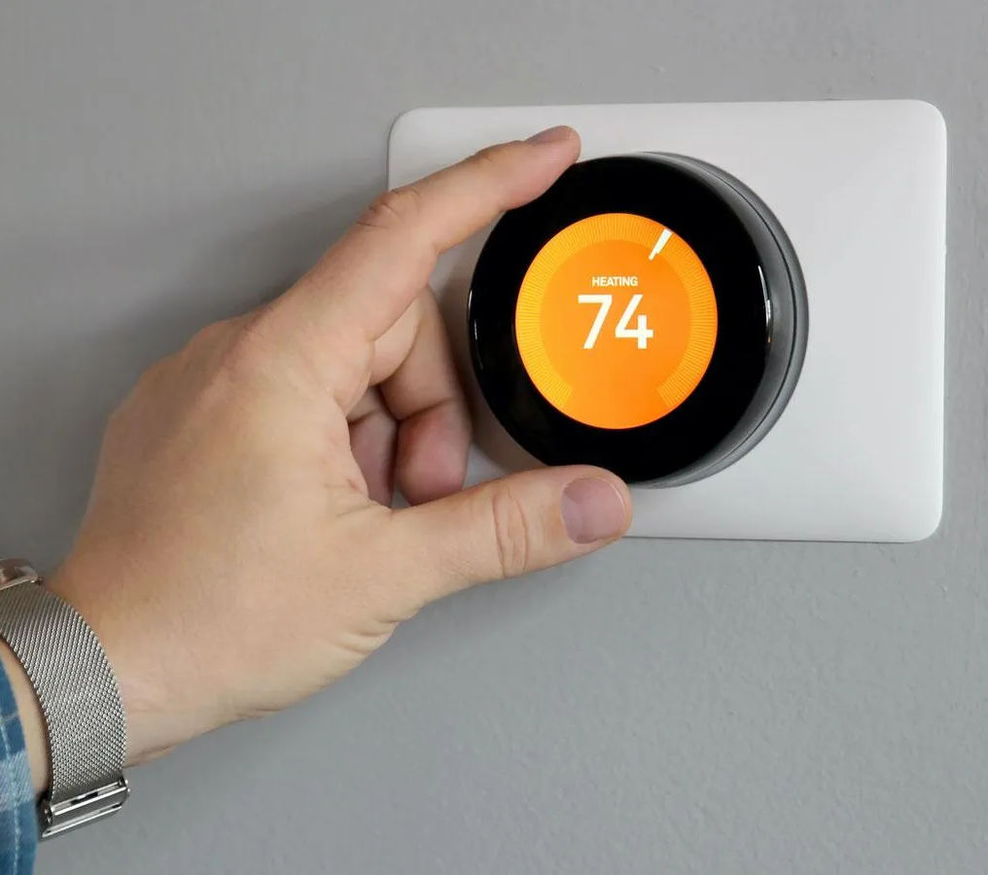
Visualizing Emotional Regulation Cont.
7
Many autistic/ADHD people think emotional regulation is like a thermostat
  “Deal with it” So it’s an instant change? Right??
  Think “Be calm” and it’s done?
People do NOT instantly change emotions
They preform tasks (mental or physical) to change how they feel
People usually identify, plan, and then manage their emotions.
But it is a skill that can be learned over time.
2024 Helping Hands Creations Inc.
Notes:
To the typical person with strong emotional regulation, they understand the social expectation of controlling their emotions to prevent others from feeling any side effects of the situation and to avoid social repercussions and conflicts
Think of someone being fired and getting a call while at Walmart
It’s perfectly normal to be very upset! But most people would want that person to calmly exit the store and then get upset and maybe cry and then do something to get their mind off of the situation
If they cried or screamed in the store, it may scare people who don’t know the situation
It might even cause security to have to escort them out
Being able to emotionally regulate yourself will improve your overall health and social situations

Slide 9
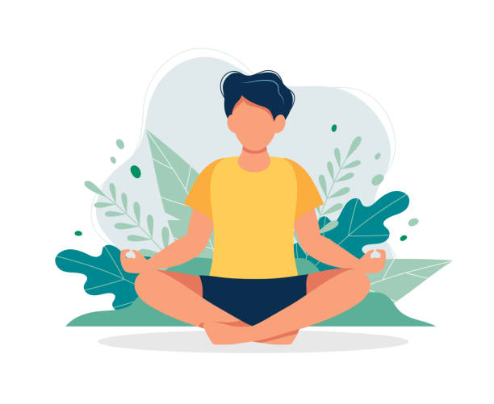
Benefits of Emotional Regulation
8
Independence
Privacy
Lessen the risk of meltdowns
Improved personal relationships
Improved social awareness
Arguments will be less intense and more about compromise and problem solving
Less stress and stress related health issues
2024 Helping Hands Creations Inc.
Notes:
Being able to emotionally regulate yourself opens so many doors!
You can become more independent, have more privacy when something happens that upsets you
You will find less conflicts day to day and notice how others navigate their emotions
Arguments will become more productive and cause less resentment
And you may even feel less sick from the emotional stress

Slide 10




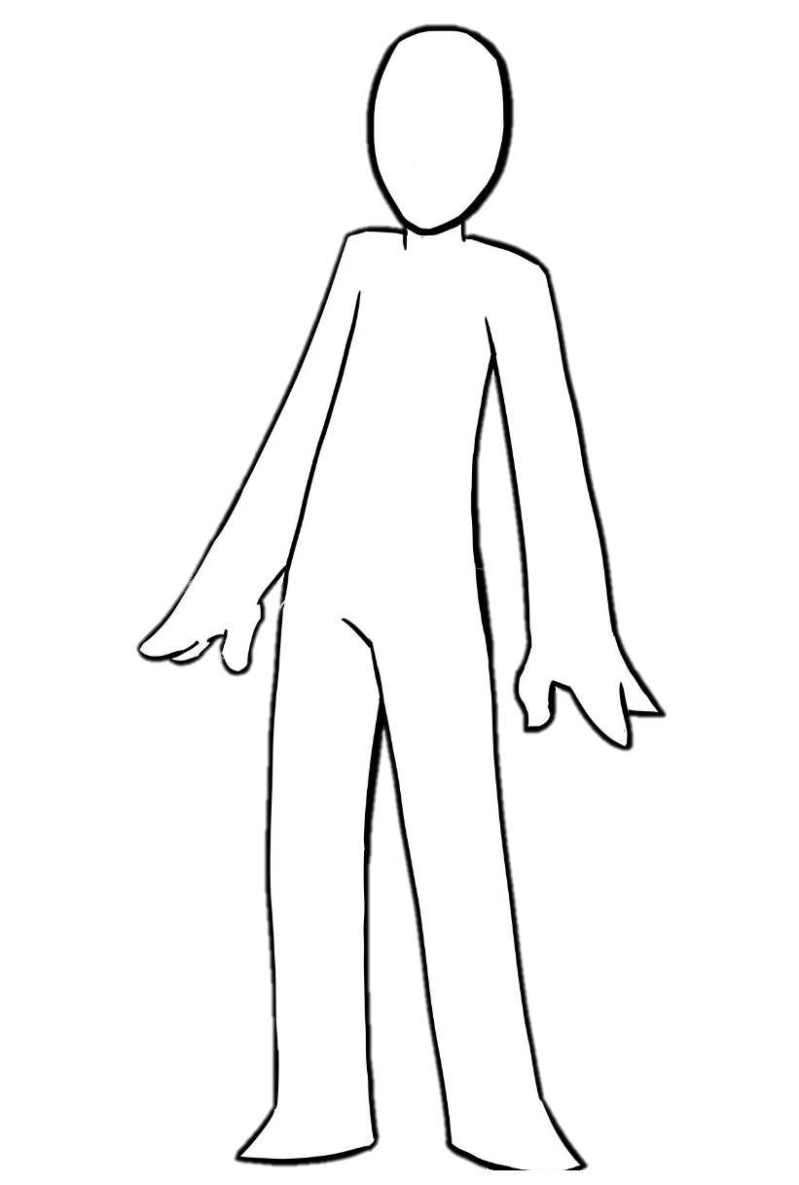

9
Why do we struggle?
We experience the world differently from the average person
Maybe we….
  Struggle to identify different emotions
  Feel strong physical responses that influence our behavior
  Were never directly taught self management skills
Whatever the case, us struggling does not mean we can’t learn
?
2024 Helping Hands Creations Inc.
Notes:
Autism and ADHD mean we experience information/emotions/situations differently from the average person
Even within our communities we are very different from one another!
So that means it IS a journey to discover our own feelings and what works for us
Each of us comes from our own unique situations, but just because we may struggle with emotional regulation doesn’t mean we can’t improve with practice

Slide 11
10
Common Myths
Just get over it!
It’s not a big deal.
Meltdowns
What people mean by this is to move on from the emotion/topic/situation
This means taking the STEPS to CHANGE how you feel.
They mean to take responsibility or manage
They don’t mean to “switch it off”
ADHD/ASD people experience the world differently from the average person
This doesn’t make anyone better or worse inherently, just different.
To you, it may FEEL HUGE! That’s okay. You can feel that big feeling and take steps to move forward.
2024 Helping Hands Creations Inc.
Notes:
One of the most common “culture clash” I have is with neurotypical people
It’s not on purpose, we just experience emotions differently and have different perspectives on what is important
We also don’t use language in the same way
What is a big deal to us, may not be to them and vice versa
We also take a lot of things they say at face value when they actually have hidden meanings behind them
“deal with it” they don’t mean to simply stop being mad, they are saying this isn’t the time or place or way to do it
They are expecting you to deal with your emotions on your own time and in whatever way you need to help with the situation
They are most likely uncomfortable or even angry at how it’s affecting them
So many of these common phrases can cause a lot of confusion, but that’s why we are here today to learn more about emotional regulation

Slide 12





How to
Emotionally Regulate?
2024 Helping Hands Creations Inc.
Notes:
Let’s explore how to emotionally regulate

Slide 13
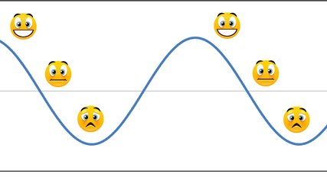
12
What is our goal?
Qualitative Method
Our goal is to return to our baseline or how you feel in your neutral state
Everyone has a different Baseline
Many different things in life will bring your emotions up or down, but the goal is to ALWAYS return to your baseline.
2024 Helping Hands Creations Inc.
Notes:
Our goal will ALWAYS to return to a calm state
This does NOT mean you stop being mad, it just means you are able to control the emotion enough that you can either walk away or continue what you were doing before
Imagine if you were SUPER EXCITED ALL THE TIME!!
That sounds exhausting! Haha
It’s not about being a super happy, go lucky person, it’s about learning to keep your emotions from being TOO intense to where they affect your daily life

Slide 14

13
What is your “Baseline”?
Physically?
Are my physical needs met?
Emotionally?
Am I switching emotions frequently?
Mentally?
Can I switch tasks easily or do I get “stuck”?
Do I feel well?
How much energy do I have during a regular day?
Do I confuse others with my moods?
Do I have any chronic health issues?
Can I recognize my emotions in a low stress environment?
Do my thoughts and actions repeat often?
Am I able to motivate myself to get up and do daily tasks?
2024 Helping Hands Creations Inc.
Notes:
So your baseline is going to feel different from other people’s baseline
I’m normally a fairly energetic person, so my leg is constantly bouncing
But if my partner was bouncing his leg, I would immediately know he is dysregulated and could use a break
Being able to self monitor will also help you prevent the situation from escalating into a meltdown so it’s important to learn how you feel usually day to day
If you know someone who struggles with emotional regulation, helping them with your observations (with their permission) may also help them

Slide 15

Every Baseline is Unique
14
I suffer from chronic pain and my pain increases when I’m stressed.
I cry very easily watching TV, so crying isn’t a good sign I’m upset.
2024 Helping Hands Creations Inc.
I’m generally have a lot of energy on an average day.
I forget to eat often and that can make me grumpy on an average day.
Notes:
Did you hurt yourself or are you feeling your chronic pain more today because you are upset?
You very suddenly don’t want to get out of bed, are you sick or did something happen?
A friend learns to ignore your Disney tears during movies because you know how to return to baseline as soon as the movie is done
your emotions’ intensity when you are hungry, no skipping lunch!

Slide 16

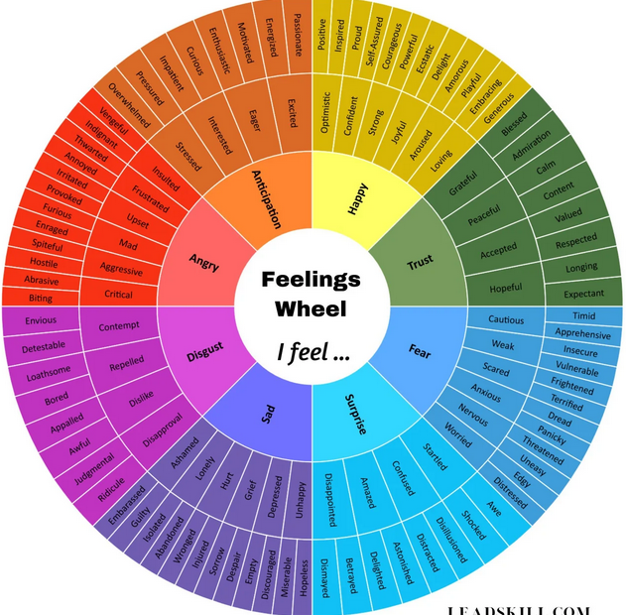
15
Identifying Emotions
There are MANY different emotions brought on by infinite situations
Feelings are unique to everyone
You will have to study how to identify YOUR different states.
Mindfulness and journaling are great for reflection
2024 Helping Hands Creations Inc.
Notes:
Each of us will experience different emotions in different ways
It’s important to realize your signs of distress will be different from people around you
Writing down or recording a video of how you feel after something happens is great way to help you puzzle your feelings after the intensity lowers

Slide 17
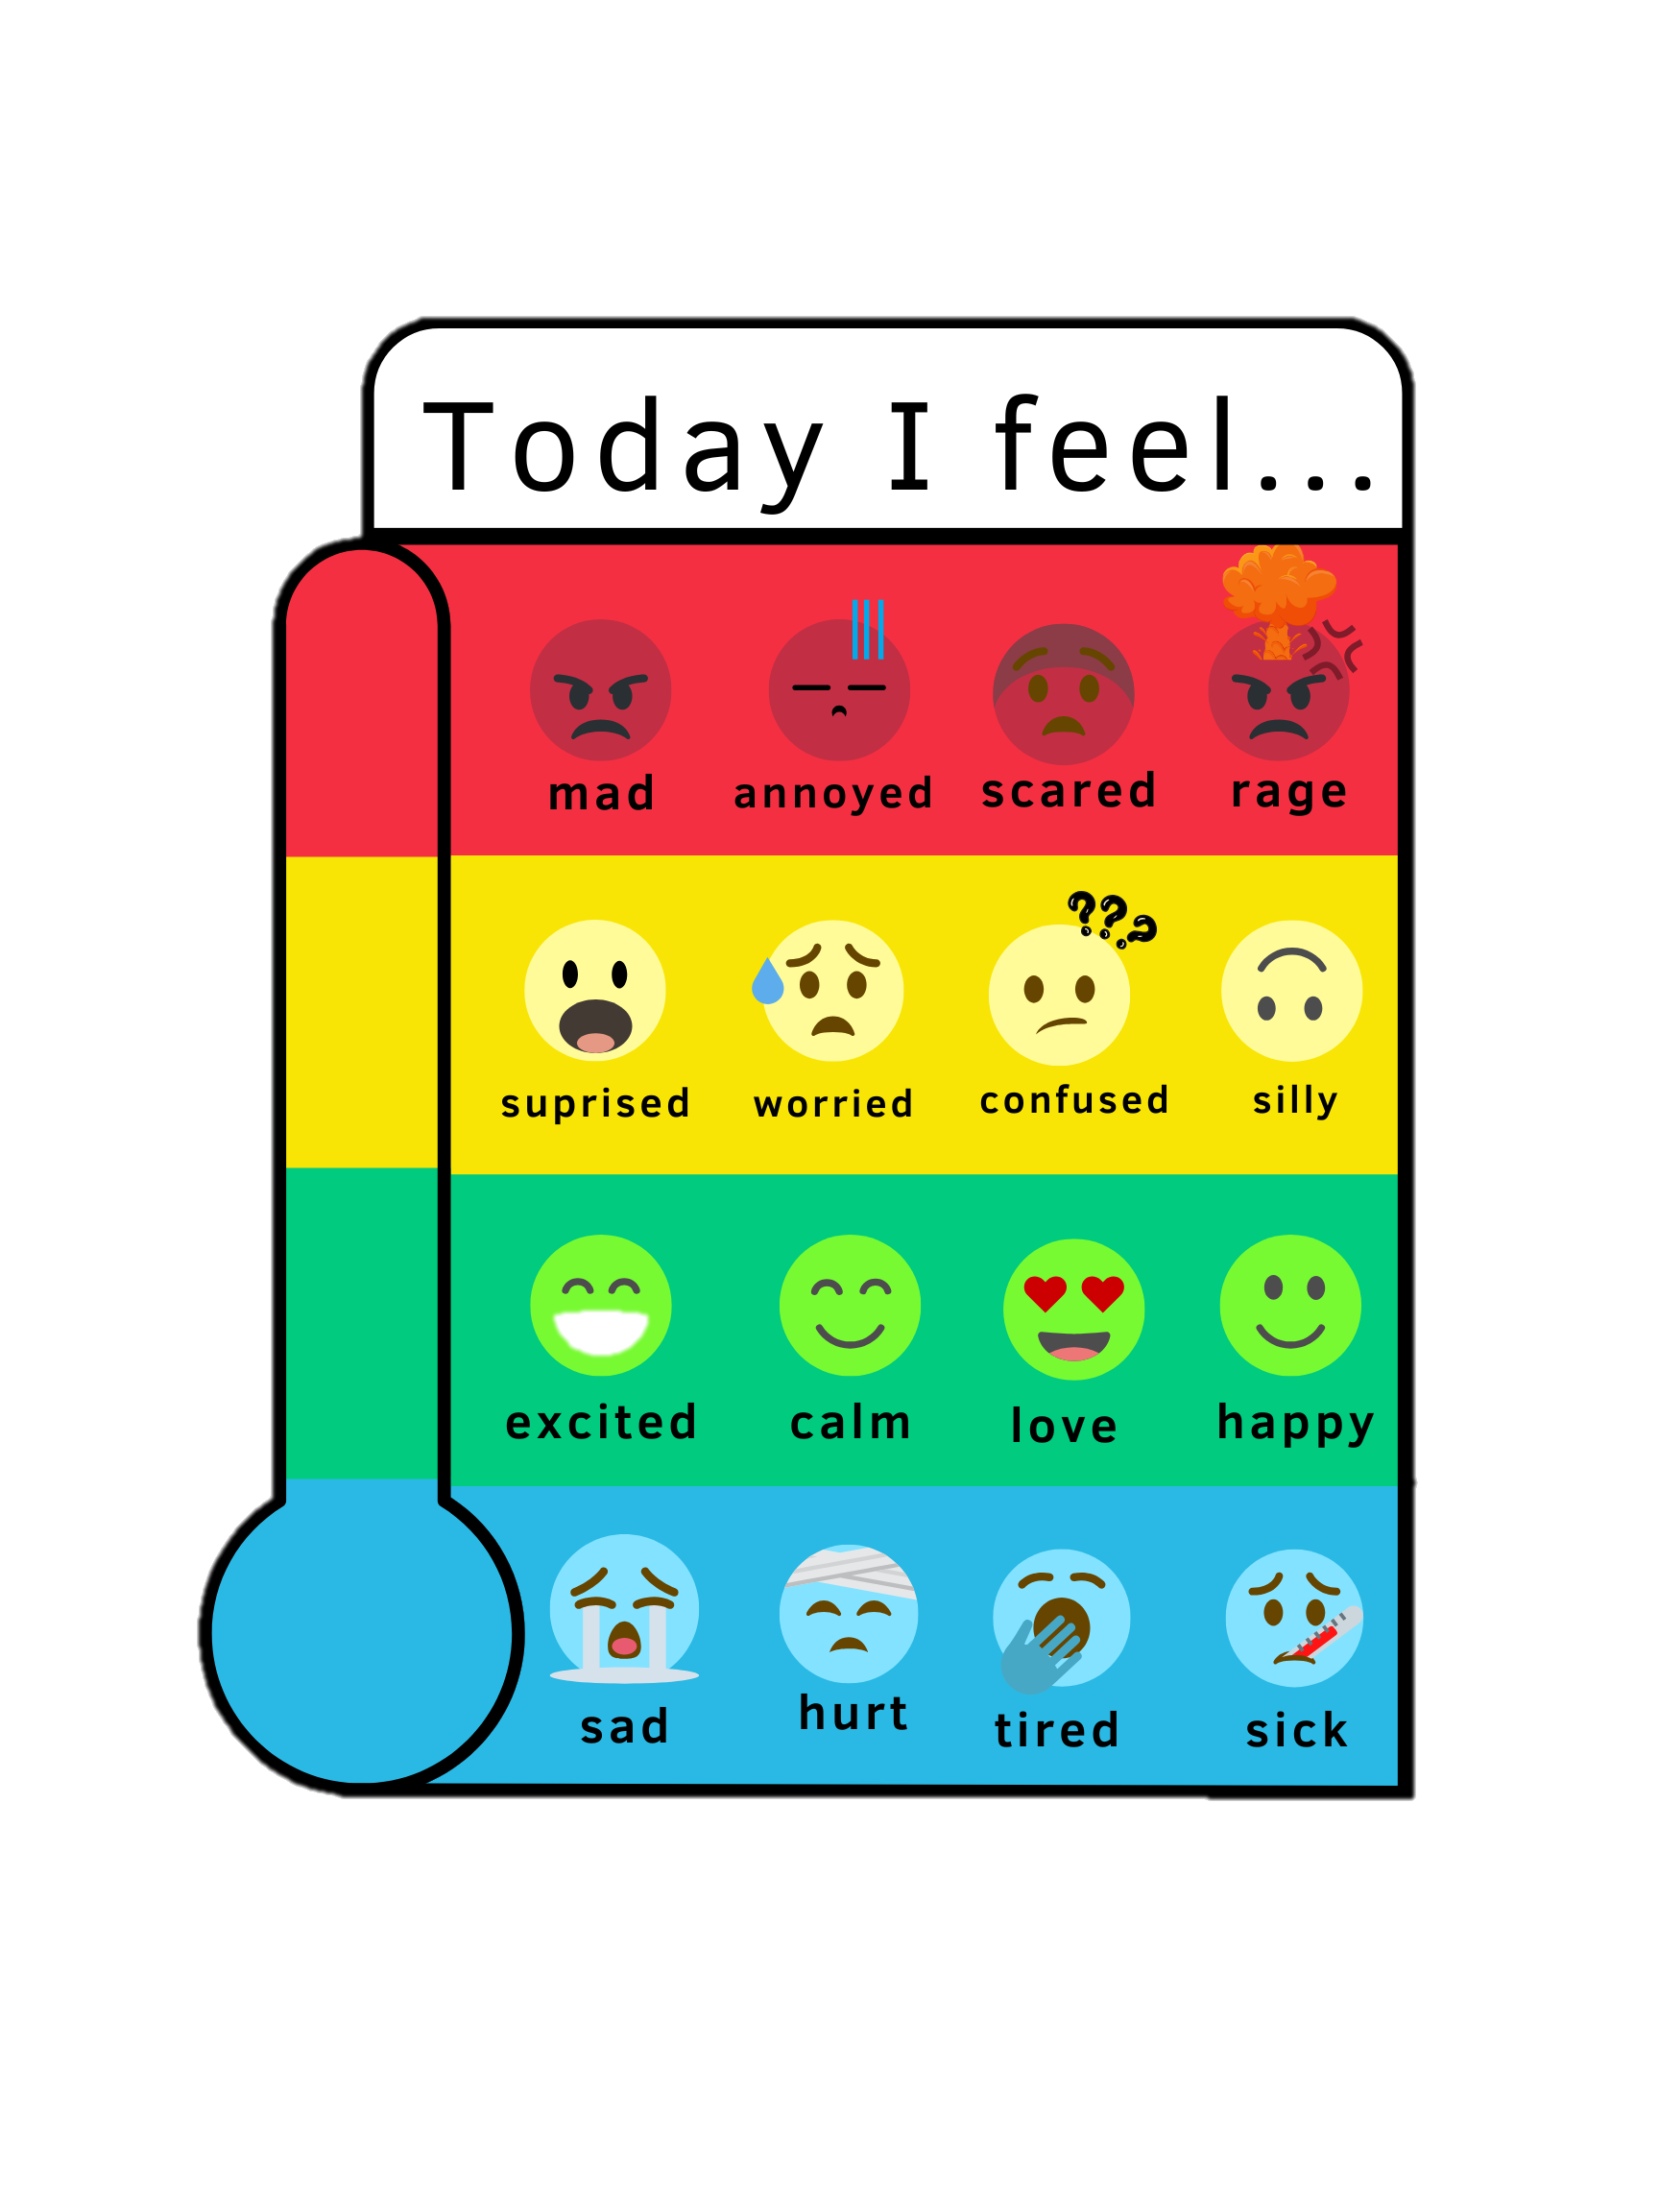



16
Differences Between High/Low Energy Emotions
“High energy” emotions:
  Anger, rage, worried, surprised are usually associated with a lot of movement
“Low energy” emotions:
  Sad, tired, sick, or hurt are usually associated with low movement
Practice "mindfulness" by asking ​
  “What physical traits do I have when I feel ___?"​
  "What caused this feeling to happen?"
2024 Helping Hands Creations Inc.
Notes:
Different emotions invoke different physical responses
Feeling “blue” may calm you down physically to the point you don’t want to get out of bed or eat/drink
That’s JUST as unhealthy as being angry and yelling or being worried and taking off on a midnight run
Being mindful of what you are feeling will help you do healthy behaviors
So when you are feeling intense emotions, remember to ask yourself questions

Slide 18
17
Identify Energizer and Relaxer Tasks
Energizers
Actions, tasks, hobbies that creates energy to influence your mood
Relaxers
Actions, tasks, hobbies that releases energy to influence your mood
2024 Helping Hands Creations Inc.
Notes:
So different activities will have different effects on your body
If you go running, it will get your blood moving, give you good feeling hormones that will give you an energizing boost
Whereas if you soak in a hot tub or listen to soft music, your body may relax
When you are struggling with emotional regulation, that doesn’t mean to ONLY do the one activity you like
If I am MAD, maybe ranting about it will make me feel MORE mad so doing a relaxing activity is better
If I am sad, reading sad stories on my phone in bed won’t help me in the long run
It’s okay to be sad or mad, but it being too INTENSE or for too LONG is not good for you

Slide 19
18
Common Self Care Activities
Energizers
Exercise
Socializing
Leaving the house
Doing a “stressful” activity like playing a competitive game
Meeting new people
Relaxers
Bathing
Napping
Drawing
Watching nature
Reading
Enjoying music or art
2024 Helping Hands Creations Inc.
Notes:
Here are common self care activities people do to either give themselves an energizing boost or to relax
Remember, what works for YOU may not work for someone else
Socializing for me is a huge boost! But for my partner, is more likely to exhaust him into being dysregulated
Disclaimer: these tasks are going to be unique to you! Maybe drawing is a high energy task because of self doubt or maybe you enjoy high energy music
It will take time and experimenting with different tasks to discover what are YOUR energizers or relaxers

Slide 20
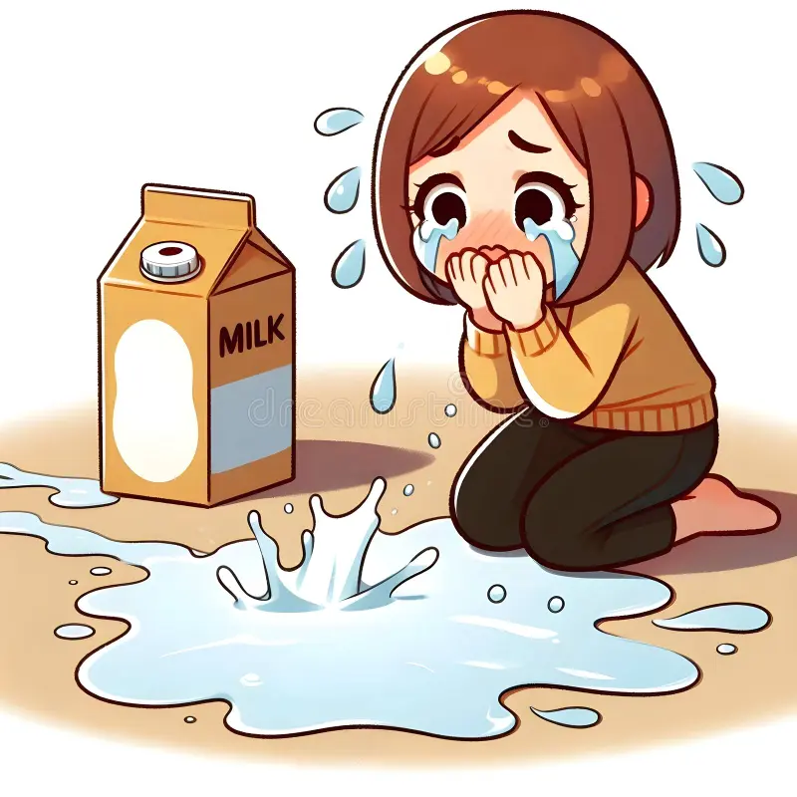
19
Reframing and Expectations
One strategy to use instead of tasks is to Reframe
Instead of taking a break, you take a second to gauge the intensity of your emotion VS the actual situation
Many times, you may discover the situation does NOT justify the intensity of the response you are doing
“If I start yelling, I need to ask myself if it’s justified”
2024 Helping Hands Creations Inc.
Notes:
The intensity of emotions can be overwhelming
The fire in your chest can be so distracting that it may cause you to do unwanted behaviors such as yelling
If the idea of taking a break is unappealing, you may want to consider using reframing and having expectations to self monitor yourself
To do this strategy, it means to consider your actions AS you are doing them and while you are dysregulated
I personally prefer using breaks to return to baseline, but with practice, mentally checking in with yourself can be an excellent strategy

Slide 21

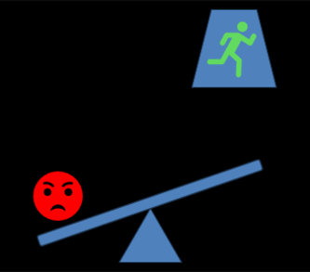
20
Regulating = Balancing
You will constantly be experiencing ups and downs in your emotions
It is up to YOU to discover what tasks you can do to emotionally regulate yourself
Creating routines, habits, and expectations for yourself can help you in returning to your baseline
2024 Helping Hands Creations Inc.
Notes:
Over time, you will discover what works and what doesn’t
And sometimes, you know what you need but you can’t do it right away
You know yourself best, the end goal is to do what you need to do to safely return to your baseline and to increase your independence
But you can always ask for help and support if you need it, it will take time and patience to discover your needs

Slide 22






Let’s Discuss
Planning and Practice
2024 Helping Hands Creations Inc.
Notes:
Let’s discuss planning and practice

Slide 23

22
Create Routines
Study when you struggled to return to your baseline
Be open to asking family and friends their opinions
Practice with reoccurring triggers
Learn more about:
  How different emotions feel for you
  What tasks help you
THEN create routines and plans to combat common situations you encounter
2024 Helping Hands Creations Inc.
Notes:
Day to day, you will have a similar schedule, so finding patterns of when you struggle with emotional regulation will come with time
Having your family and friends help you realize when you may be dysregulated can be very helpful, but it’s also important to communicate to them WHEN you want their help
Having reliable fall back plans of what to do when you are upset will help you be more successful

Slide 24




23
Some Regulating Plans
Social Anxiety
Lingering Hurt
After company, I feel dysregulated
I will do a relaxing activity and read to return to baseline.
I still feel hurt over a resolved issue
I will do an energizing activity and cook a big meal to give myself a boost.
2024 Helping Hands Creations Inc.
Overwhelming Anger
Sick or Recovering
Sometimes I yell during arguments.
I will reframe and make sure any yelling I do is justified for the situation at hand.
I still feel sad and struggling to get up while I’m recovering
I will set alarms to make sure I take my meds and eat/drink.
Notes:
Here are several scenarios of times different people struggling with their emotional regulation
Notice they use either a physical or mental activity to help them return to baseline
Now sometimes, you will just BE upset
These are strategies for when you want to lower the intensity of the emotion or start to recover and move forward from the situation

Slide 25
24
Allow Feedback
Gaining Perspective
It is hard to tell when you are “overreacting” if you are distressed
Having trust in your support system is important so you have an outside source to help you monitor your behavior
What you are feeling is REAL, but that doesn’t excuse negative behaviors or actions
Allow Support
Many people will not understand why you struggle to identify emotions
But allowing others to support you, you gain trust in their support, and they gain trust that you are allowing them to help
2024 Helping Hands Creations Inc.
Notes:
It’s very important to allow feedback when you are struggling with emotional regulation
For the simple reason, it can be hard to notice from US that we may be overracting to the situation or are “stuck” with the emotions
But trust has to be earned and it’s a two-way street
The biggest mistake other people will make is mistaking our emotions as not our real feelings
Just because I need to calm down before we continue the argument does NOT mean I am not “really” mad
Being dysregulated means the intensity is making the situation more difficult, but the root cause is still there
If the cause of the rift is with the support system, it’s important to acknowledge the feelings being presented

Slide 26
25
Note to Family/Friends
Discuss communicating breaks BEFORE conflicts
The other person IS feeling BIG feelings and is struggling with them
Navigating arguments with you will require patience on both sides
Disengage and Give Feedback
Don’t dismiss Feelings
“Let’s continue to talk after a break.”
“I feel hurt how this conversation is going, can we continue later?”
“You are dysregulated and need to calm down now.”
“Why are you overreacting? Go to your room and deal with it.”
2024 Helping Hands Creations Inc.
Notes:
Many people see autistic/adhd people’s intense responses as a sign we are “unreasonable” but it is not the feelings that are unreasonable, it is our behaviors that can be problematic
Lowering the intensity of our emotions just helps us gain control over our responses. Having an argument while being dysregulated helps no one but telling someone “you are just dysregulated” will make them feel dismissed.
Disengage, give feedback, and return to the conversation when both sides can communicate productively. A danger of using therapy like language when engaging with loved ones is…you aren’t a therapist, you are part of the situation
No one should feel attacked, the autistic/adhd person should NOT feel less than for struggling with their emotional regulation. It is our behaviors that should be judged rather than our struggle with emotional regulation.
It is part of our independence to ask for help in the ways WE agree too, that is why it’s important to discuss strategies before emotions are high

Slide 27
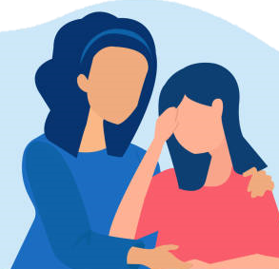
26
Recovery Communication
Gentle with Yourself
Guilt or shame are common when you struggle with emotional regulation
It’s okay because you are here taking steps to take care of yourself
Gentle with Others
Remember, they don’t have to understand to accept you and support you.
Even if you don’t mean to hurt others, we are still responsible for our behaviors and words.
Talking to them and discussing what happened is the start of the recovery for them too
2024 Helping Hands Creations Inc.
Notes:
If you struggle with emotional regulation, you have to acknowledge the possible problematic behaviors that happen as a result:
Yelling
Cursing
Breaking things
Crying uncontrollably
Storming off
Etc.
People WILL worry, be scared, or even angry
By learning to emotionally regulate, you are helping reducing the chance of repeating these problematic behaviors
The point is NOT to stop feeling emotions, it’s to control the intensity, have strategies to help you accomplish the goal of returning to your baseline, and gain independence

Slide 28
27
Mindfulness and Journaling
Mindfulness
Both methods are tools for :
Identifying and keeping track of your emotions and how it affects you in your daily life.
Focusing on what you are feeling and doing in the moment.
Journaling
Keeping track of your moods, triggers, health, and emotions
The more you learn about yourself, the easier time you will have transferring skills to unique situations.
2024 Helping Hands Creations Inc.
Notes:
Mindfulness is a whole topic on it’s own, but the importance of it and journaling is HUGE
Learning how your emotions feel, when they happen, and how to return to baseline will all depend on how much “work” you put into learning about your needs
It will always be easier to deal with familiar situations, but the more you record past events and monitor your own behaviors, the less often you will find yourself relying on outside sources to discover what’s wrong

Slide 29
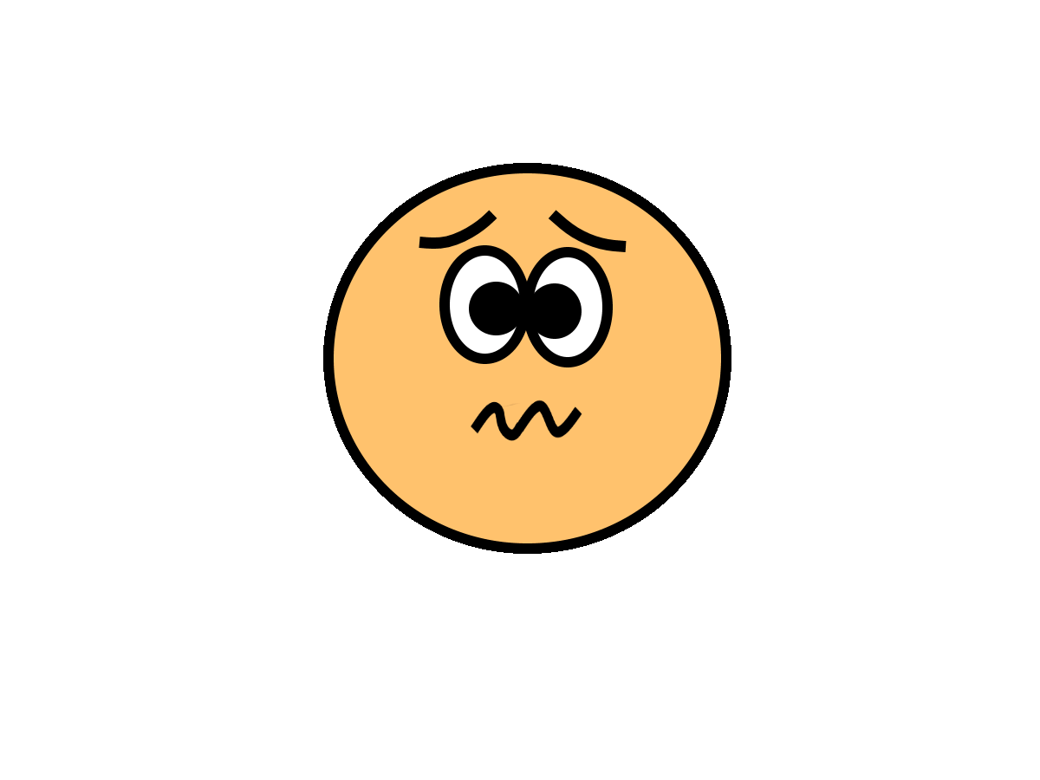
28
Activity One: Describe Your Emotion
I have always struggled describing my emotions but visualizing them has helped me with identifying them and their intensity levels
Describe how an emotion makes you feel either:
      emotionally, physically, or mentally
      You may draw, write, or even pick songs to represent the emotion you are describing
2024 Helping Hands Creations Inc.
Notes:
It was very helpful to me personally to visualize what my emotions felt like.
Whatever method you choose: art, writing, music, drawing, etc, the point is to try and discover the different “intensities” of emotions for you
Mine is:
For me, when my emotions intensify, my skin starts buzzing and I feel the emotion becoming spikey in my chest.
That is when I realize I need to leave the situation and use a task to help me regulate.

Slide 30
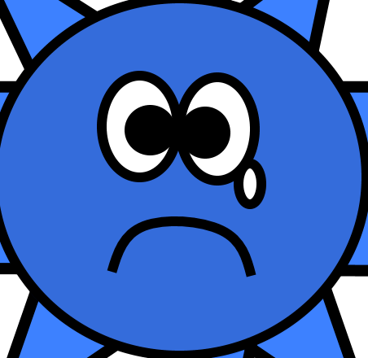
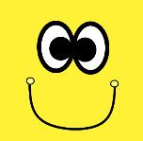
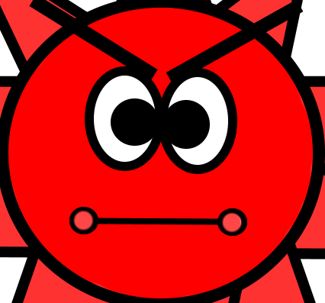
29
Activity Two: Return to Baseline
Bad days are going to happen, BUT we can plan out things to DO ​
Plan an activity you would like to do when sad or angry
Name an example trigger that may have occurred with a solution
Got into an argument with a friend
Go walk the dog around the block
Got into an argument online
Block the messages and take a bath
2024 Helping Hands Creations Inc.
Notes:
Practice by picking an emotion/trigger/possible activity to help you return to baseline
This is just brainstorming, you will discover it’s best to explore many options to find out what works best for you

Slide 31
30
Follow Through
It will take practice, time, and lots of communication
But learning more about how YOU feel different emotions, how to identify them, and finding out what helps? It WILL make a difference.
2024 Helping Hands Creations Inc.
Notes:
It is hard to remember to take care of yourself when you are overwhelmed with stress, sensory input, and feelings.
But the goal is to be happy, you can only get to that point if you practice self care and take a step towards independence.

Slide 32
THANK YOU
Created By : Sam Sandate White
2024 Helping Hands Creations Inc.
Notes:
This is a FREE RESOURCE created by Sam Sandate White if you are viewing via video or PDF
Helping Hands powerpoint is NOT to be used in paid services without gaining permission via purchase rights which is not available at this time.

