Slide 1


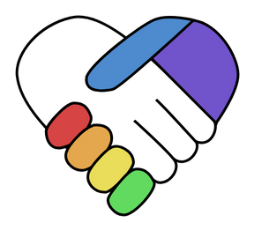



The Essentials
Created By: Sam Sandate White
2024 Helping Hands Creations Inc.
Notes:
Hello! My name is Sam, I created Helping Hands Creations to provide free resources for the ADHD/Autistic communities or anyone they may be useful to. I am creating these free resources because I believe in providing my community the tools they need to succeed and without it being blocked behind paywalls. I highly encourage you to share my work to anyone in need, my only request is to please avoid giving my resources to businesses who would use it for monetary reasons. If you are interested in a private or group lesson, please contact me through my patreon.

Slide 2
Meltdown Plans
Created By: Sam Sandate White
2024 Helping Hands Creations Inc.
Notes:
Today’s focus is making Meltdown Plans. Meltdowns can be scary and confusing, but I’m here to help you learn how to manage and reduce the amount of meltdowns you have so you can regain control and independence in your life.

Slide 3
2
Overview
Reoccurring and frequent meltdowns affect the quality of life autistic and ADHD people experience. To navigate meltdowns, we will explore:
What is a Meltdown?
What is a Meltdown plan?
How to prevent and recover from Meltdowns?
2024 Helping Hands Creations Inc.
Notes:
You first need to understand why meltdowns happen
Having a plan will help you navigate them once they happen.
And finally, the whole point of this presentation is to prevent and reduce the amount of meltdowns you have overall.

Slide 4
3
AGENDA
What are they?
Creating Plans
Prevention and Recovery
Why plan Meltdowns?
What are benefits to planning?
How to make a Meltdown plan?
  Identifying Triggers & Needs
  Rumbling Vs Baseline
  Location Specific
  Plan Your Communication Methods
Example Plan
Avoid OR Replace
Recovery Communication
Following Through
Activities
What are Meltdowns?
Why do autistic/ADHD people have Meltdowns?
Common Myths
2024 Helping Hands Creations Inc.
Notes:
Today’s agenda

Slide 5

Let’s Explore
Meltdowns
2024 Helping Hands Creations Inc.
Notes:
Let’s explore what meltdowns are

Slide 6
5
What are Meltdowns?
Meltdowns are the result of being over stimulated.
The intensity of the meltdown depends on the person and their environment.
Meltdowns can look very different person to person.
Some common behaviors are:
Crying
Yelling
Running away
Unable to communicate
Repetitive behaviors;
  i.e. rocking, head banging
2024 Helping Hands Creations Inc.
Disclaimer: Not every ASD/ADHD person may experience meltdowns
Notes:
A common misconception is that meltdowns are chosen actions
Just as people don’t choose whether they are: freeze, run, or attack, neither can people who have meltdowns

Slide 7
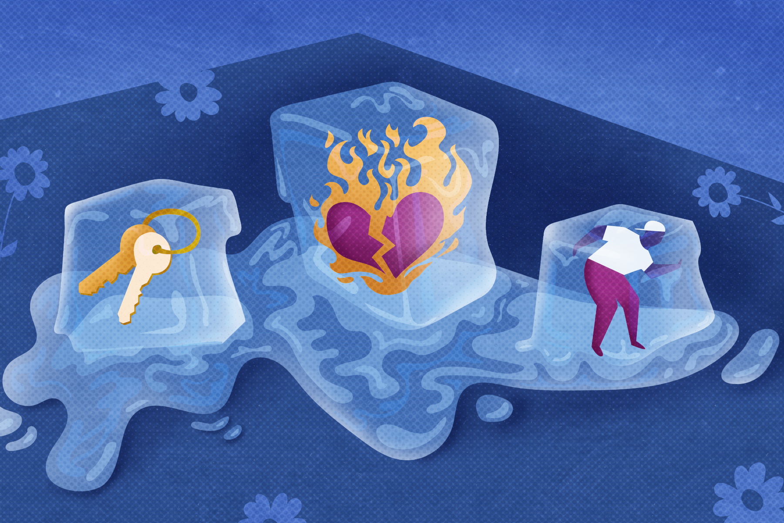
6
Experiencing Meltdowns
Meltdowns cannot be eliminated, only reduced and managed.
Managing and reducing meltdowns is a skillset built over time
It is NOT our fault having meltdowns
While we cannot control how our bodies take in information, we CAN control our environments.
2024 Helping Hands Creations Inc.
Notes:
We did not choose the bodies we were born or how our bodies react to stress, so carrying guilt for when things go wrong will not improve things, but taking ownership of our bodies, we are accepting that we can DO THIS
By changing our actions, we will improve the outcomes of meltdowns and improve our lives

Slide 8
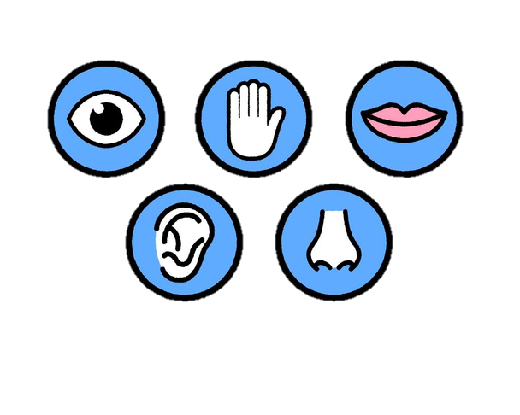

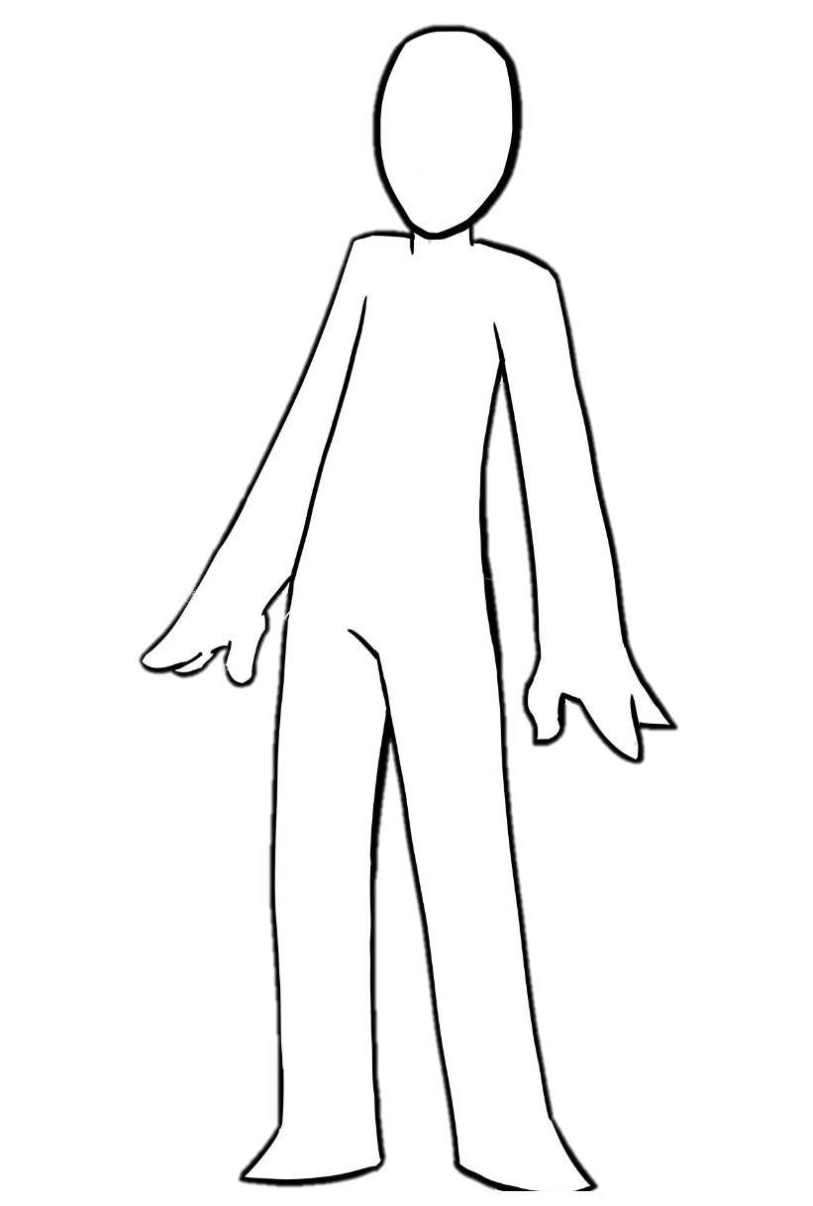

7
Experiencing Meltdowns Cont.
?
We absorb information constantly around us
The average person will receive information from their senses and their body tells them what they need
But autistic/ADHD people may struggle to process information and a meltdown is the outcome instead
However, uncontrollable meltdowns will affect your relationships in all aspects of your life
2024 Helping Hands Creations Inc.
Notes:
Think of your computer, remember a time that your computer freezed from too many commands
It then struggled to listen and instead struggled to do all your commands at once
Just like a computer, sometimes a “hard restart” is necessary in order stop processing all the failed input of information
Sometimes, it’s better to allow yourself time to forget all the input information and start over with fewer commands in a controlled environment

Slide 9
8
Common Myths
It’s just a tantrum!!
It’s for attention.
Meltdowns
A tantrum ends once the person gets the result they want.
A meltdown will need time and certain sensory conditions to end.
A tantrum can trigger a meltdown.
Meltdowns are painful and embarrassing.
They can even be dangerous.
ADHD/ASD people do not have to justify a well-documented experience
2024 Helping Hands Creations Inc.
Notes:
A common problem in adhd/asd families is determining “is it a meltdown or a tantrum”
I’m here to tell you a secret, you don’t need to figure it out most of the time
Many adhd/asd people struggle to transition or change subjects, thus work themselves up to a meltdown
When you think about it, during a tantrum, the person is getting angry/worked up/ overstimulated
It’s a good habit to try calming down, changing tasks, or purposely relaxing
Research has shown, exercising or ranting while angry can accidentally arouse the body and thus making the situation worse
A tantrum can morph into a meltdown when left unchecked

Slide 10




Let’s Build
Meltdowns Plans
2024 Helping Hands Creations Inc.
Notes:
Let’s build meltdown plans

Slide 11

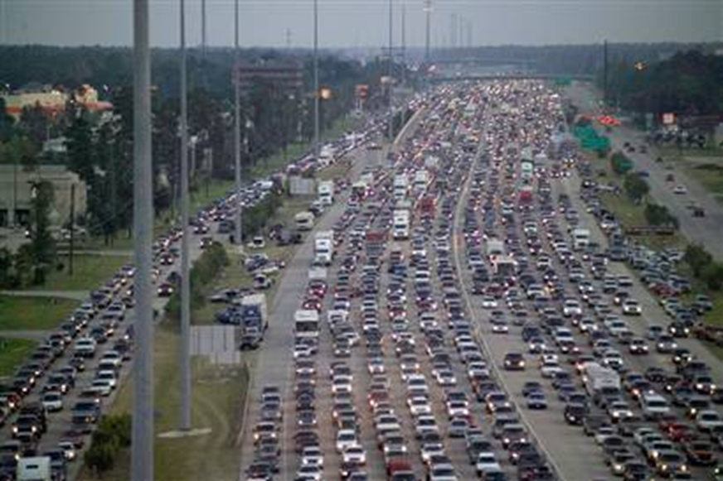
10
Why Plan a Meltdown?
Why do we make emergency plans?
To prevent “worst case scenarios”
We WANT to reduce the amount of pain we will experience
2024 Helping Hands Creations Inc.
Notes:
Just as we plan how to exit a city from a hurricane path or even how to exit a house from a fire, it helps to have a plan
The worst thing you can do to yourself is try to plan while in a crisis
You want the time, calm, and rational from planning ahead of time

Slide 12
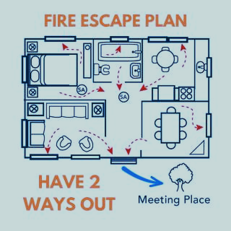
11
Benefits to Planning
1
Easier to communicate with others your needs and triggers
2024 Helping Hands Creations Inc.
2
You are prepared with all the supplies you need
3
Having a plan will increase confidence and reduce day to day anxiety
Notes:
Planning before hand has so many benefits to you and the people around you
Give yourself AND other people the best possible outcome by planning ahead
Try to remember, while it is YOU who feels the direct pain of meltdowns, people around us are also affected
Them having a plan and being reassured will also grant them confidence in possible meltdown situations

Slide 13






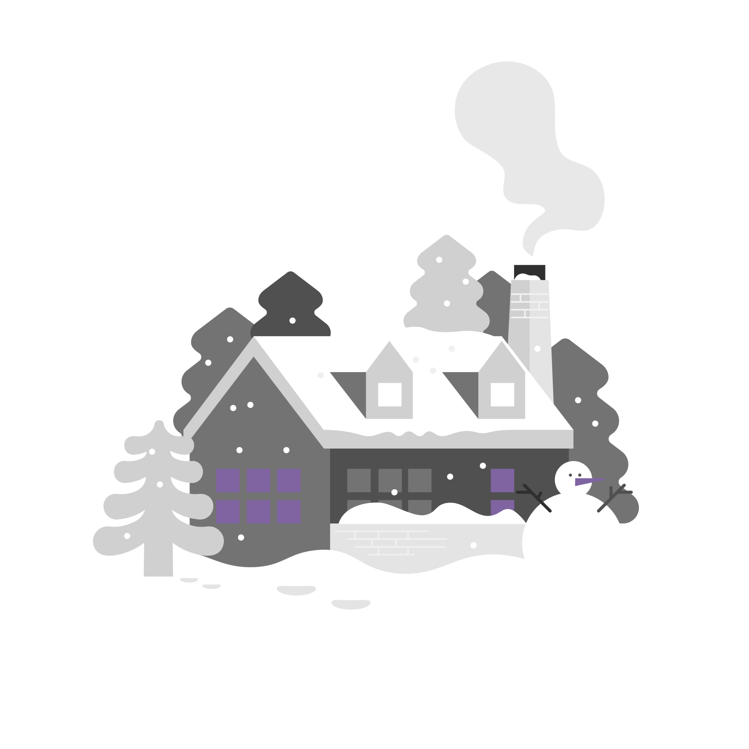














12
How do you make a Meltdown Plan?
Identify Triggers/Needs
Location Specific
2024 Helping Hands Creations Inc.
Rumbling Vs Baseline
Communication Methods
Notes:
These are the four main areas you need to identify while planning a meltdown plan

Slide 14



13
Identifying Triggers and Needs
Triggers
Remember past meltdowns
Any input that creates overwhelming stress that is hard to manage.
Needs
What you need to re-center yourself and go back to baseline
2024 Helping Hands Creations Inc.
Notes:
Trigger is not anything that makes you slightly upset
While I can be slightly upset from receiving a bad grade, I am personally WAY more affected if I feel “cornered” in a one on one verbal discussion
Needs are going to be activities or necessities that help calm your body down back to baseline
In other words, its not ANYTHING you like, you need to be planning for things that help you calm down
The whole point is to return to baseline, remembering how past meltdowns went will help you narrow down triggers and needs

Slide 15
14
Rumbling Vs Baseline
Rumbling
May have encountered a trigger
You may have STRONG feelings or feel PHYSICALLY ill
Common signs:
Goal
  Is to return to baseline
  How your body and mood usually feel
Stressed
Anxious
Depressed
Sick
Stimming more
Struggle transitioning
Easily frustrated
Headaches or stomachache
*** This is the time to plan an exit and go rest ***
2024 Helping Hands Creations Inc.
Notes:
If you can learn to identify your rumbling stage, you are preventing the worst possible outcomes
It’s scary to think about, but having meltdowns in public is DANGEROUS, learning to identify the rumbling stage will help you plan safe exits
If you can take a break and return to baseline, then you may be able to stay at your event, BUT if you cannot return to baseline, it is better to exit

Slide 16

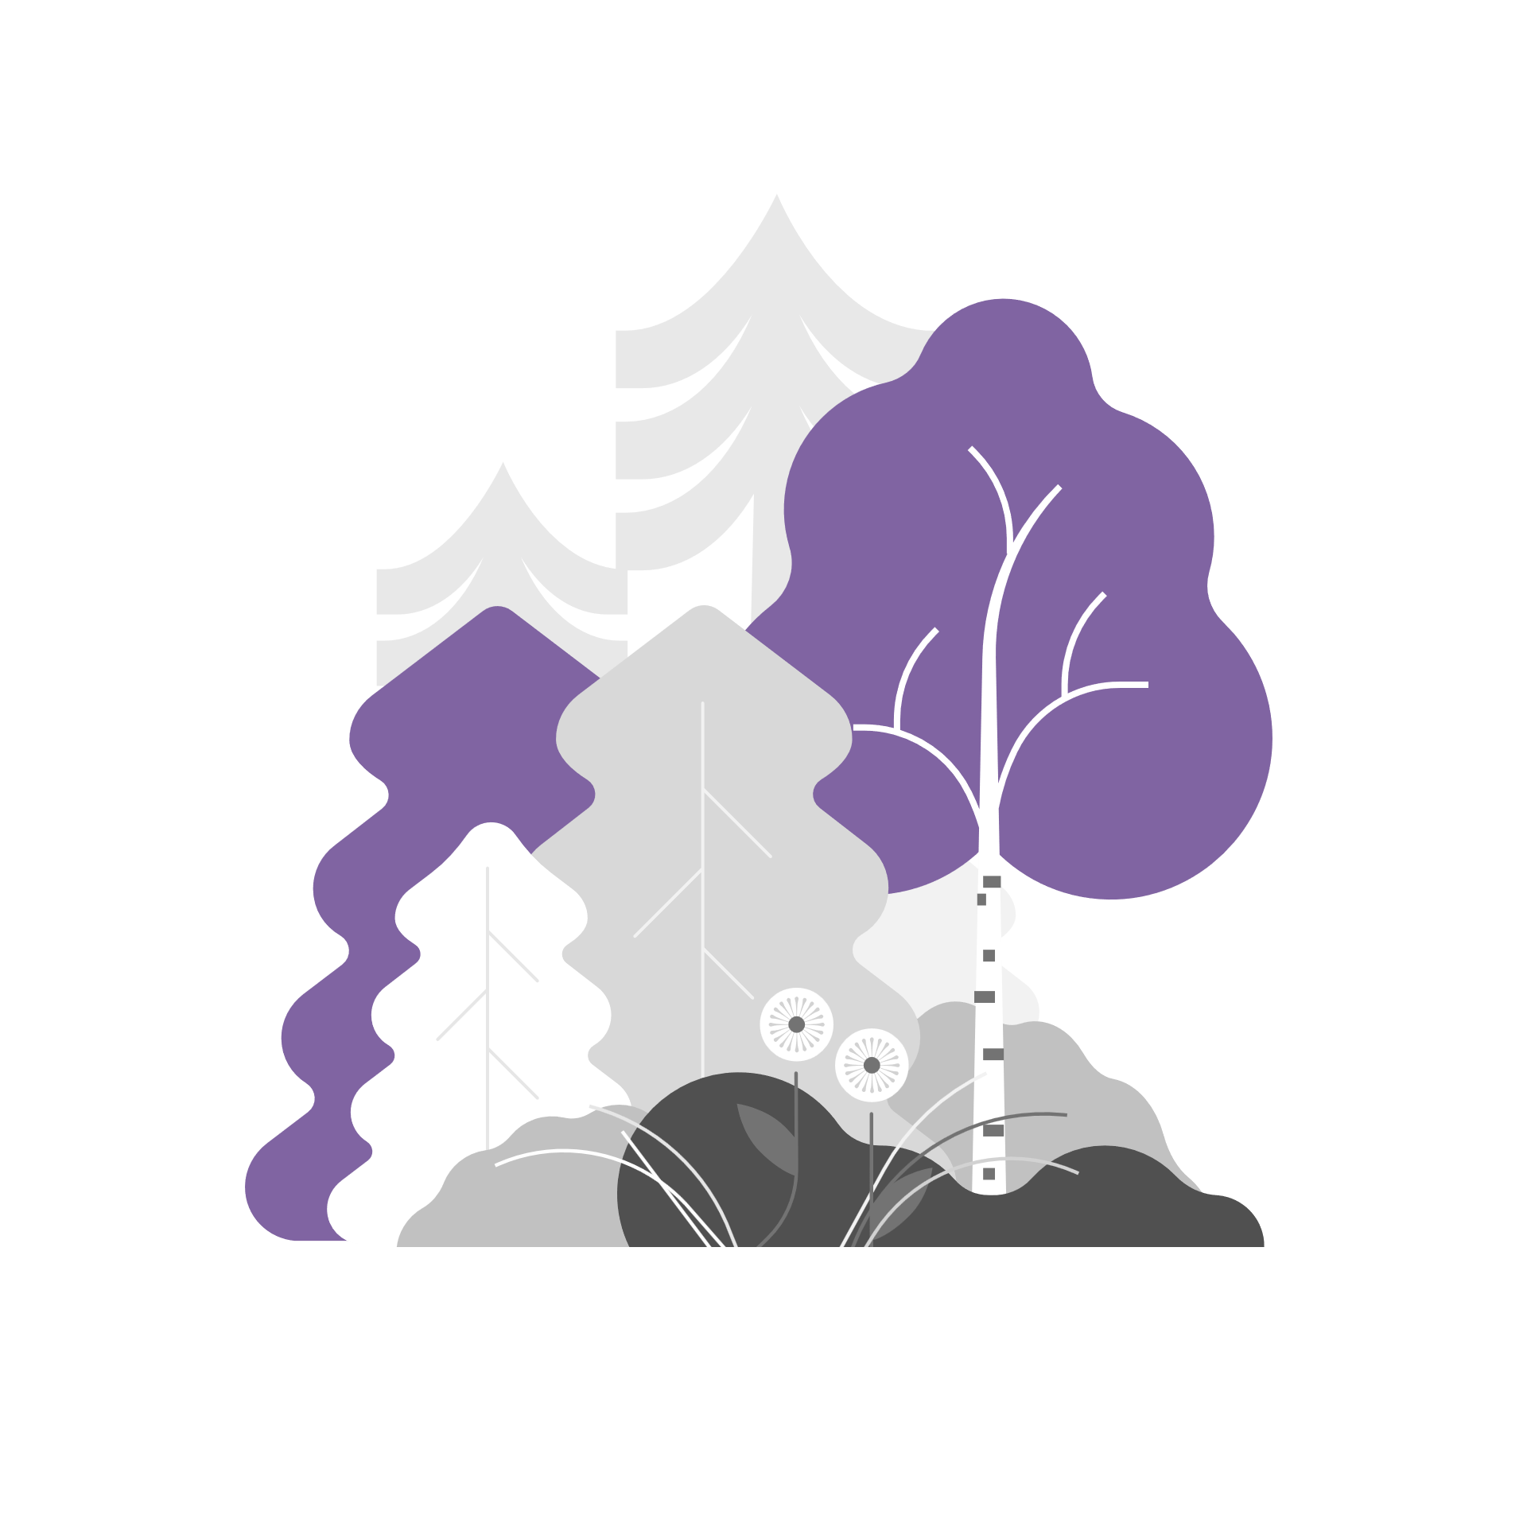
15
Plan for Different Locations
Qualitative Method
Different environments are going to need different plans
School, work, or even a vacation won’t have the same “rules” as home
Plan for complications, what can go wrong so you can work around it
2024 Helping Hands Creations Inc.
Quantitative Method
Notes:
It’s important to remember, if you are in a public place, they do NOT understand what is going on, the population that understands what autism/adhd is actually very small
It is safer for YOU and for them if you can leave OR isolate yourself
Planning how to talk to workers and let them know you need to be isolated is important for the “worse case” scenario

Slide 17
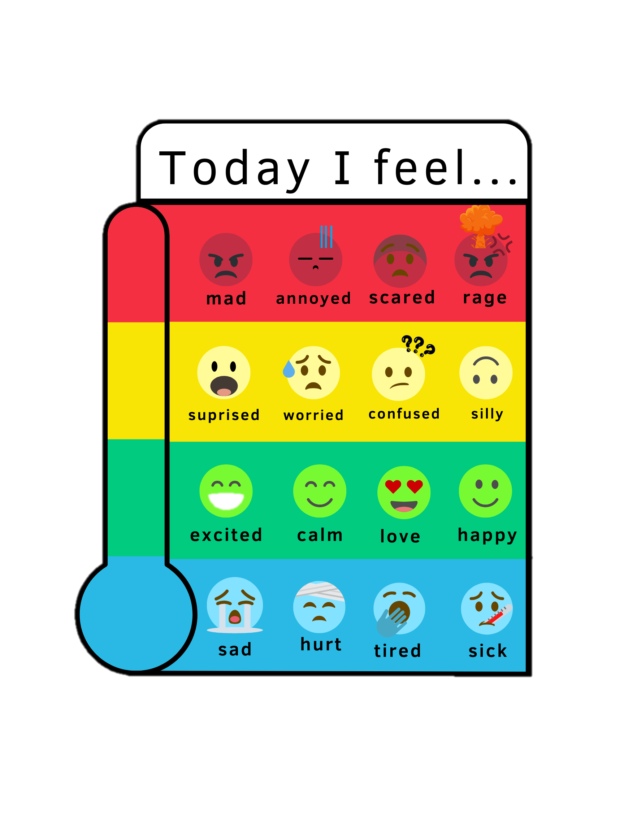



16
Plan Your Communication
Communication also gets HARD before/during/after
Consider using "signals":​
  Hand signs, code words, colors, numbers​
Practice "mindfulness" by asking ​
  "What am I feeling right now?"​
  "What is causing this feeling?"
2024 Helping Hands Creations Inc.
Notes:
Remember not to assume people know you are uncomfortable
Communicating with others is necessary to let others know what you are feeling
But you can only communicate how you are feeling by KNOWING what you are feeling
Practice knowing the signs to what you are feeling
And some emotions may be easier than others, I can very easily tell when I am sad but struggle greatly to tell when I am getting frustrated
Keeping a journal and noting the physical signs along with emotional signs may help

Slide 18


17
Example Plan A
Identify Triggers/Needs
Location Specific
I need to be alone in the dark and quiet.
Triggers can be feeling “wrong” or “confused” or life stressors.
If I can’t go home, use my phone to make white noise and go to a restroom.
If home, go to room
2024 Helping Hands Creations Inc.
Rumbling Vs Baseline
Communication
I usually get paranoid or anxious.
I also feel sick the morning of a meltdown.
Call in to work ASAP.
Text “I need to leave” or ASL
They are allowed to redirect me to my room until I am back to baseline.
Notes:
Here is my personal plan
You may or may not relate to my plan.
Every plan is catering to YOUR NEEDS
If yours doesn’t look like another autistic/adhd person, that’s okay!
The point is to help YOU, not for your to “look or react” like everyone else

Slide 19
18
Example Plan B
Identify Triggers/Needs
Location Specific
If at school, my teacher calls my mom and I get taken to a quiet space.
If home, go to room and mom helps me set up
I need to be alone in my room with a weighted blanket and a familiar TV show
Triggers are unexcepted transitions
2024 Helping Hands Creations Inc.
Rumbling Vs Baseline
Communication
I usually get angry and repetitive.
I cannot tell when I’m in the rumbling phase and rely on feedback from family, friends, and teachers.
I have a plan that if I can’t talk or cry for too long, I need my mom.
I trust adults to lead me home.
Notes:
Here is my personal plan for my 4 yr old daughter
You may or may not relate to her plan.
Every plan is catering to YOUR NEEDS
If yours doesn’t look like another autistic/adhd person, that’s okay!
The point is to help YOU, not for your to “look or react” like everyone else

Slide 20
19
Example Plan C
Identify Triggers/Needs
Location Specific
I need to be surrounded by noise, TV show, games, and music
Triggers are being overstimulated
I rumble AND have meltdowns at home.
It’s my safe space where I can unmask.
2024 Helping Hands Creations Inc.
Rumbling Vs Baseline
Communication
I usually get angry or upset.
I am usually in the rumbling stage the first hour after work.
Text “home please” or use ASL if with my partner
Once home, I let them know I need alone time for around an hour.
Notes:
Here is my personal plan for my husband
You may or may not relate to his plan.
Every plan is catering to YOUR NEEDS
If yours doesn’t look like another autistic/adhd person, that’s okay!
The point is to help YOU, not for your to “look or react” like everyone else

Slide 21





Let’s Discuss
Prevention and Recovery
2024 Helping Hands Creations Inc.
Notes:
Let’s discuss prevention and recovery

Slide 22


21
Avoid or Replace Triggers
Being flexible and finding compromises will be key
Example: Trigger is busy stores
  Avoid: Shopping online and doing pickup or delivery
  Replace: Finding smaller stores or shopping early hours
You will NOT find compromises for everything
Sometimes, it will be balancing pros and cons
You may “lose out” on some experiences, but there are plenty of other choices and your quality of life will be richer by reducing meltdowns
2024 Helping Hands Creations Inc.
Notes:
It’s okay to feel sad that you can’t do an activity “like everyone else”
Just remember that EVERY person in the world is born with advantages and disadvantages
I am not saying that we are guaranteed to use those advantages/disadvantages, but we are born with them
Just as autism/adhd has the disadvantage of giving you meltdowns and preventing you from doing certain tasks, you may personal strengths associated with your diagnoses
Just how I would NEVER suggest someone with a physical/medical/demographic other than autism/adhd can’t do something, YOU aren’t just your diagnoses
Try to consider, some people have medicine they may take, or tasks they can’t do due to physical limitations, just as THEY are NOT less than because of their condition, you are NOT less than either
The point is to live a good life, that goes for anyone born to any situation

Slide 23

22
Recovery Communication
Gentle with Yourself
Talking may be hard or confusing after a meltdown
Tip: write your thoughts down before having a conversation
Gentle with Others
Witnessing a meltdown can be scary
Even the most understanding family or friends can still feel hurt from the episode
Talking to them and discussing what happened is the start of the recovery for them too
2024 Helping Hands Creations Inc.
Notes:
First of all, it can seem a bit odd to think of others after a meltdown
Let’s use an example: I am NOT saying a broken leg isn’t painful to the one who is injured
But to the family or friends who witnessed the break? It was probably terrifying!
That is not including if there were behaviors that accidentally hurt the people around us
Taking responsibility isn’t the same as saying you were in control during the meltdown
But all actions have consequences, whether they are good or bad
By communicating with others and moving forward in your recovery together, you are accepting their feelings as well
Preventing meltdowns from affecting your relationships is part of the prevention process and will make future meltdowns easier as a result

Slide 24

23
Physical Recovery
Treat it like you would a Cold
Rest, fluids, easy to digest foods, etc
Your body just went through trauma, YOU deserve rest
Remember, no details outside your home
Many people will not understand what meltdowns are.
Simply say you are “sick and recovering”, no one is owed your private medical information.
2024 Helping Hands Creations Inc.
Notes:
There is a physical, mental. And emotional toll from having meltdowns
Treat yourself kindly during your recovery period, the sooner you return to your baseline, the sooner you can move on
It can be very hard to avoid saying “meltdown” to people you know: co workers, family members, friends, etc
But you are reducing the amount of complications if you keep the information of what happened to yourself
Why did you have one?
What triggered it?
Why didn’t you prevent it?
Did you follow the plan?
After a meltdown, the questioning or even prejudice can negatively affect you
No one needs to know you had a meltdown if it’s avoidable
Simply say “I’m sick and need a day to recover”, the less information you give, the more time you can focus on resting
However, I HIGHLY suggest telling roommates or family members you will with so they may follow your meltdown plan and prevent miscommunication
Only avoid telling them if you feel it would make the situation worse, aka a difficult roommate situation or something similar

Slide 25
24
Activity One: Share Your Needs
Let’s take a moment to brainstorm some of our needs
Either in chat or using your phone:
  Narrow down your needs into emoji form
  Or write down on paper
Here are mine:
🧊🌊💊🐕😴⚫🎧🛏️
2024 Helping Hands Creations Inc.
Notes:
Meltdown plans don’t need to be complicated, you just need the essential parts to make it work and communicate to those who need to know
Mine is:
Drink ice water if I cannot escape right away
Take pain medicine or pet my dog if I’m at the rumbling stage
If a meltdown is unavoidable, take a nap in a dark and quiet room, use noise canceling headphones if needed

Slide 26
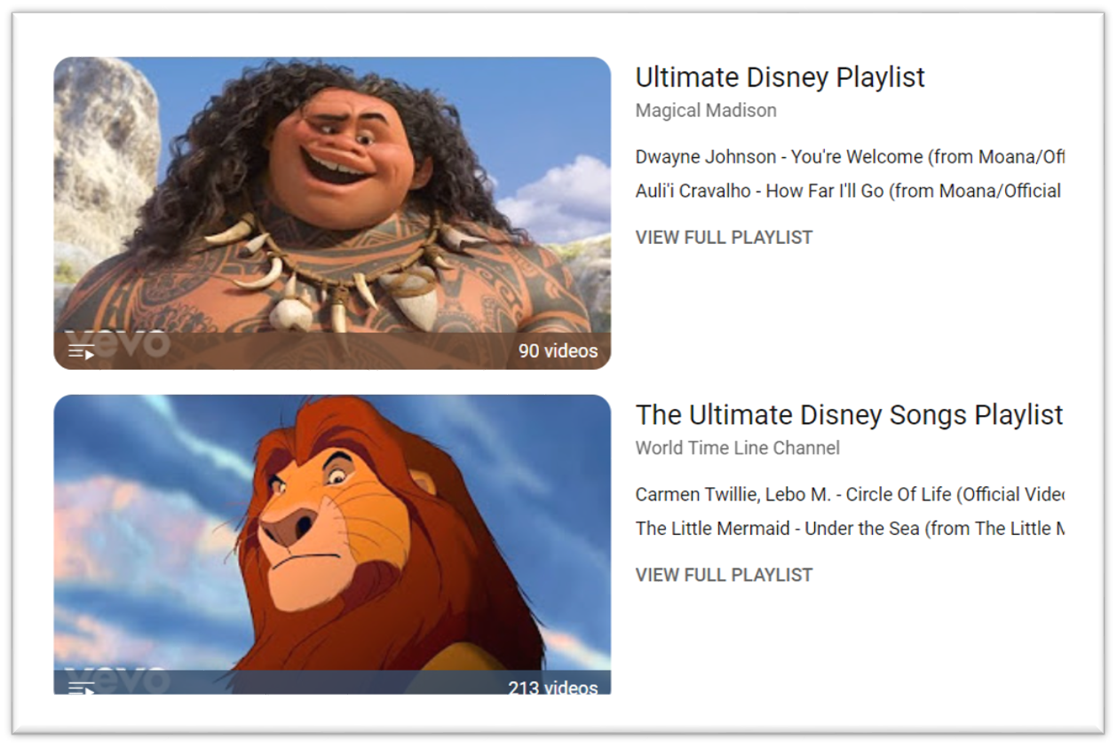
25
Activity Two: Prepare
Bad days are going to happen, BUT we can plan out things to DO ​
We are going to make “Chill-Lax” Lists! ​
Make one of the following: ​
  A playlist for music​
  List of things to draw​
  Bad day gaming library
  List of care items to keep in a box
2024 Helping Hands Creations Inc.
Notes:
Prepare things to do during your rumbling stage to help you return back to baseline
Having to not think on the spot of “what to do” to calm down is very important
The first couple of times will be the hardest, but the goal is to make it a routine
“when I am upset, I will draw something from my list”
“when I am struggling, I will go to my stress box and take a relaxing bath and nap”

Slide 27
26
Follow Through
It will take practice, time, and lots of communication
But having a plan WILL help manage meltdowns and prevent them impacting your life and lowering your quality of life.
2024 Helping Hands Creations Inc.
Notes:
It is hard to remember to take care of yourself when you are overwhelmed with stress, sensory input, and feelings.
But the goal is to be happy, you can only get to that point if you practice self care and take a step towards independence.

Slide 28
THANK YOU
Created By : Sam Sandate White
2024 Helping Hands Creations Inc.
Notes:
This is a FREE RESOURCE created by Sam Sandate White if you are viewing via video or PDF
Helping Hands powerpoint is NOT to be used in paid services without gaining permission via purchase rights.
To gain access to the FULL POWERPOINT, you may purchase it from the Helping Hands shop.

